Slide 1
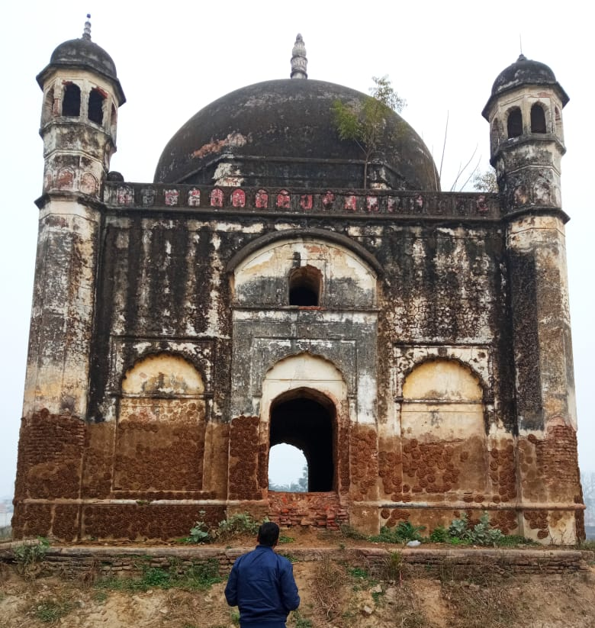
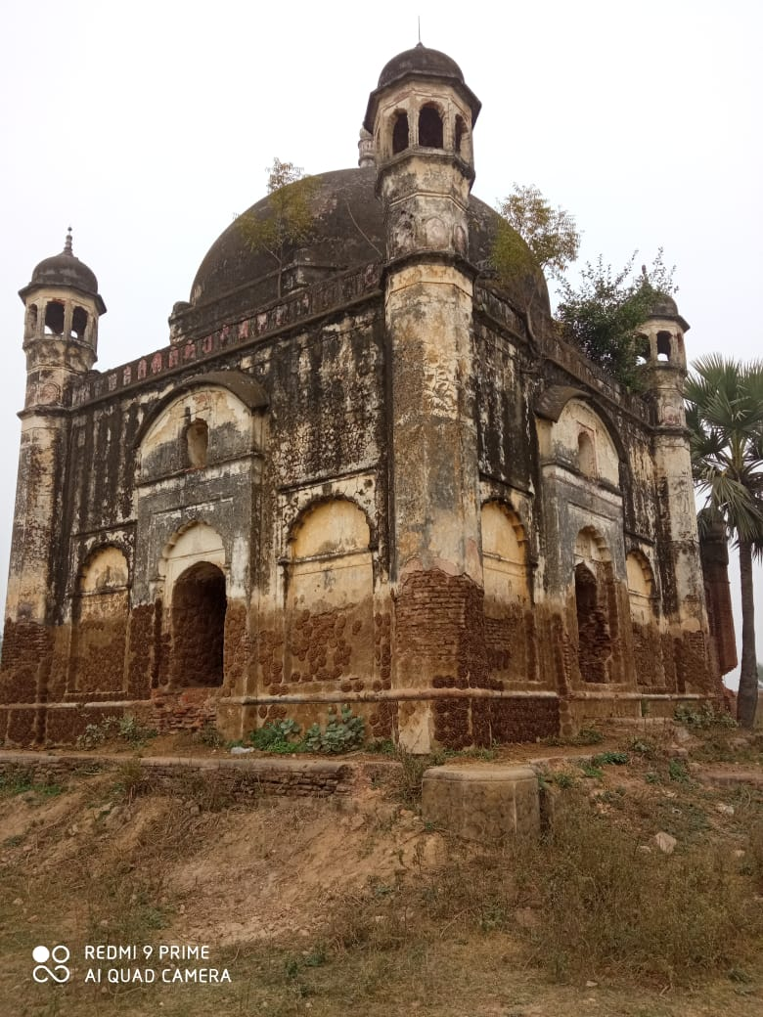
Architectural Assessment
This Heritage building is one of the building with mixed style of architecture with beautiful painting and carving works. Carvings can be seen on the front elevation and extensively used in the whole building.

Slide 2
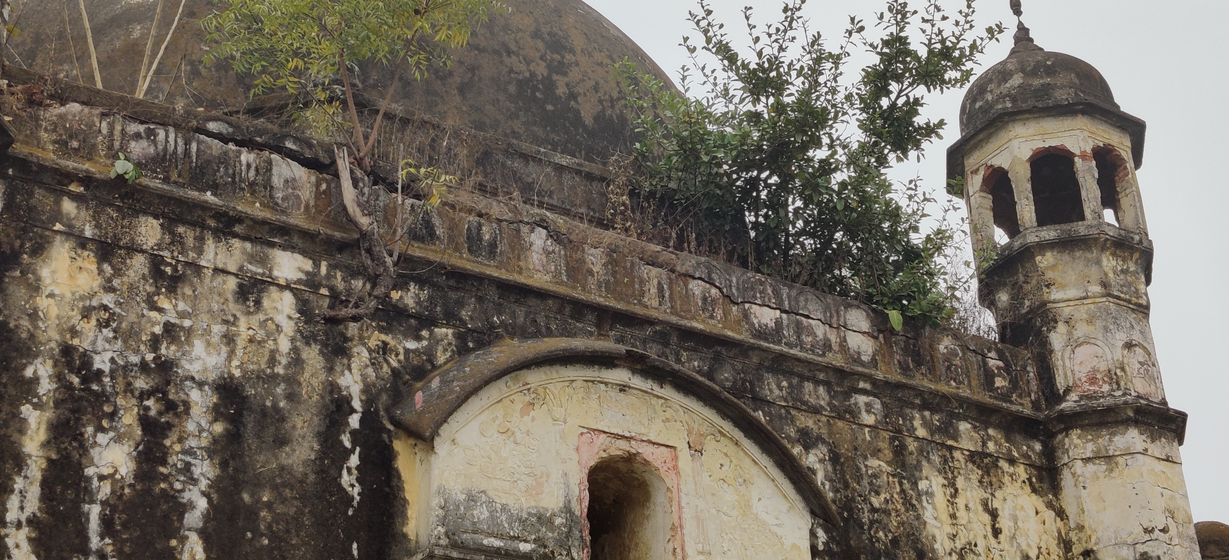
Architectural Assessment
Beautiful Ornamental Carvings encrypted on the top of building facade

Slide 3
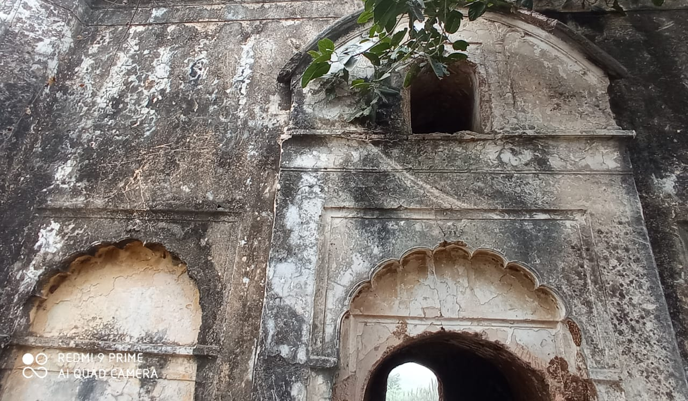
Architectural Assessment
The Building Façade having Ornamental gables and consists all sides of the building structure.

Slide 4
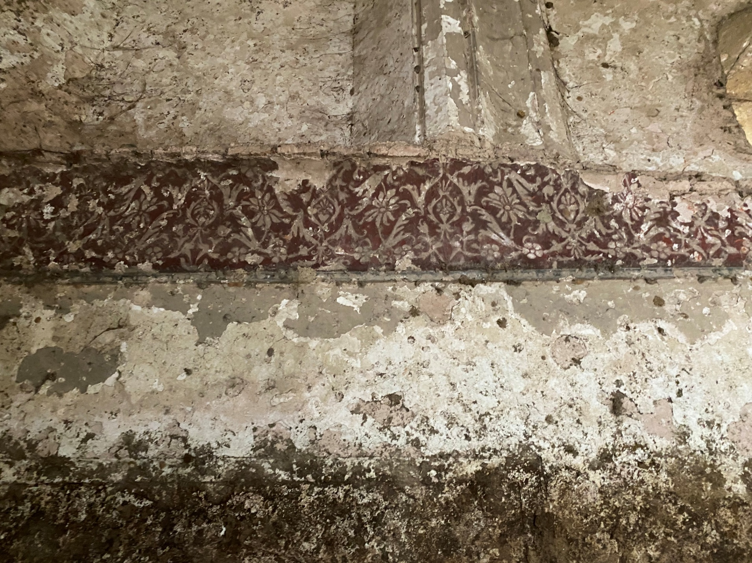
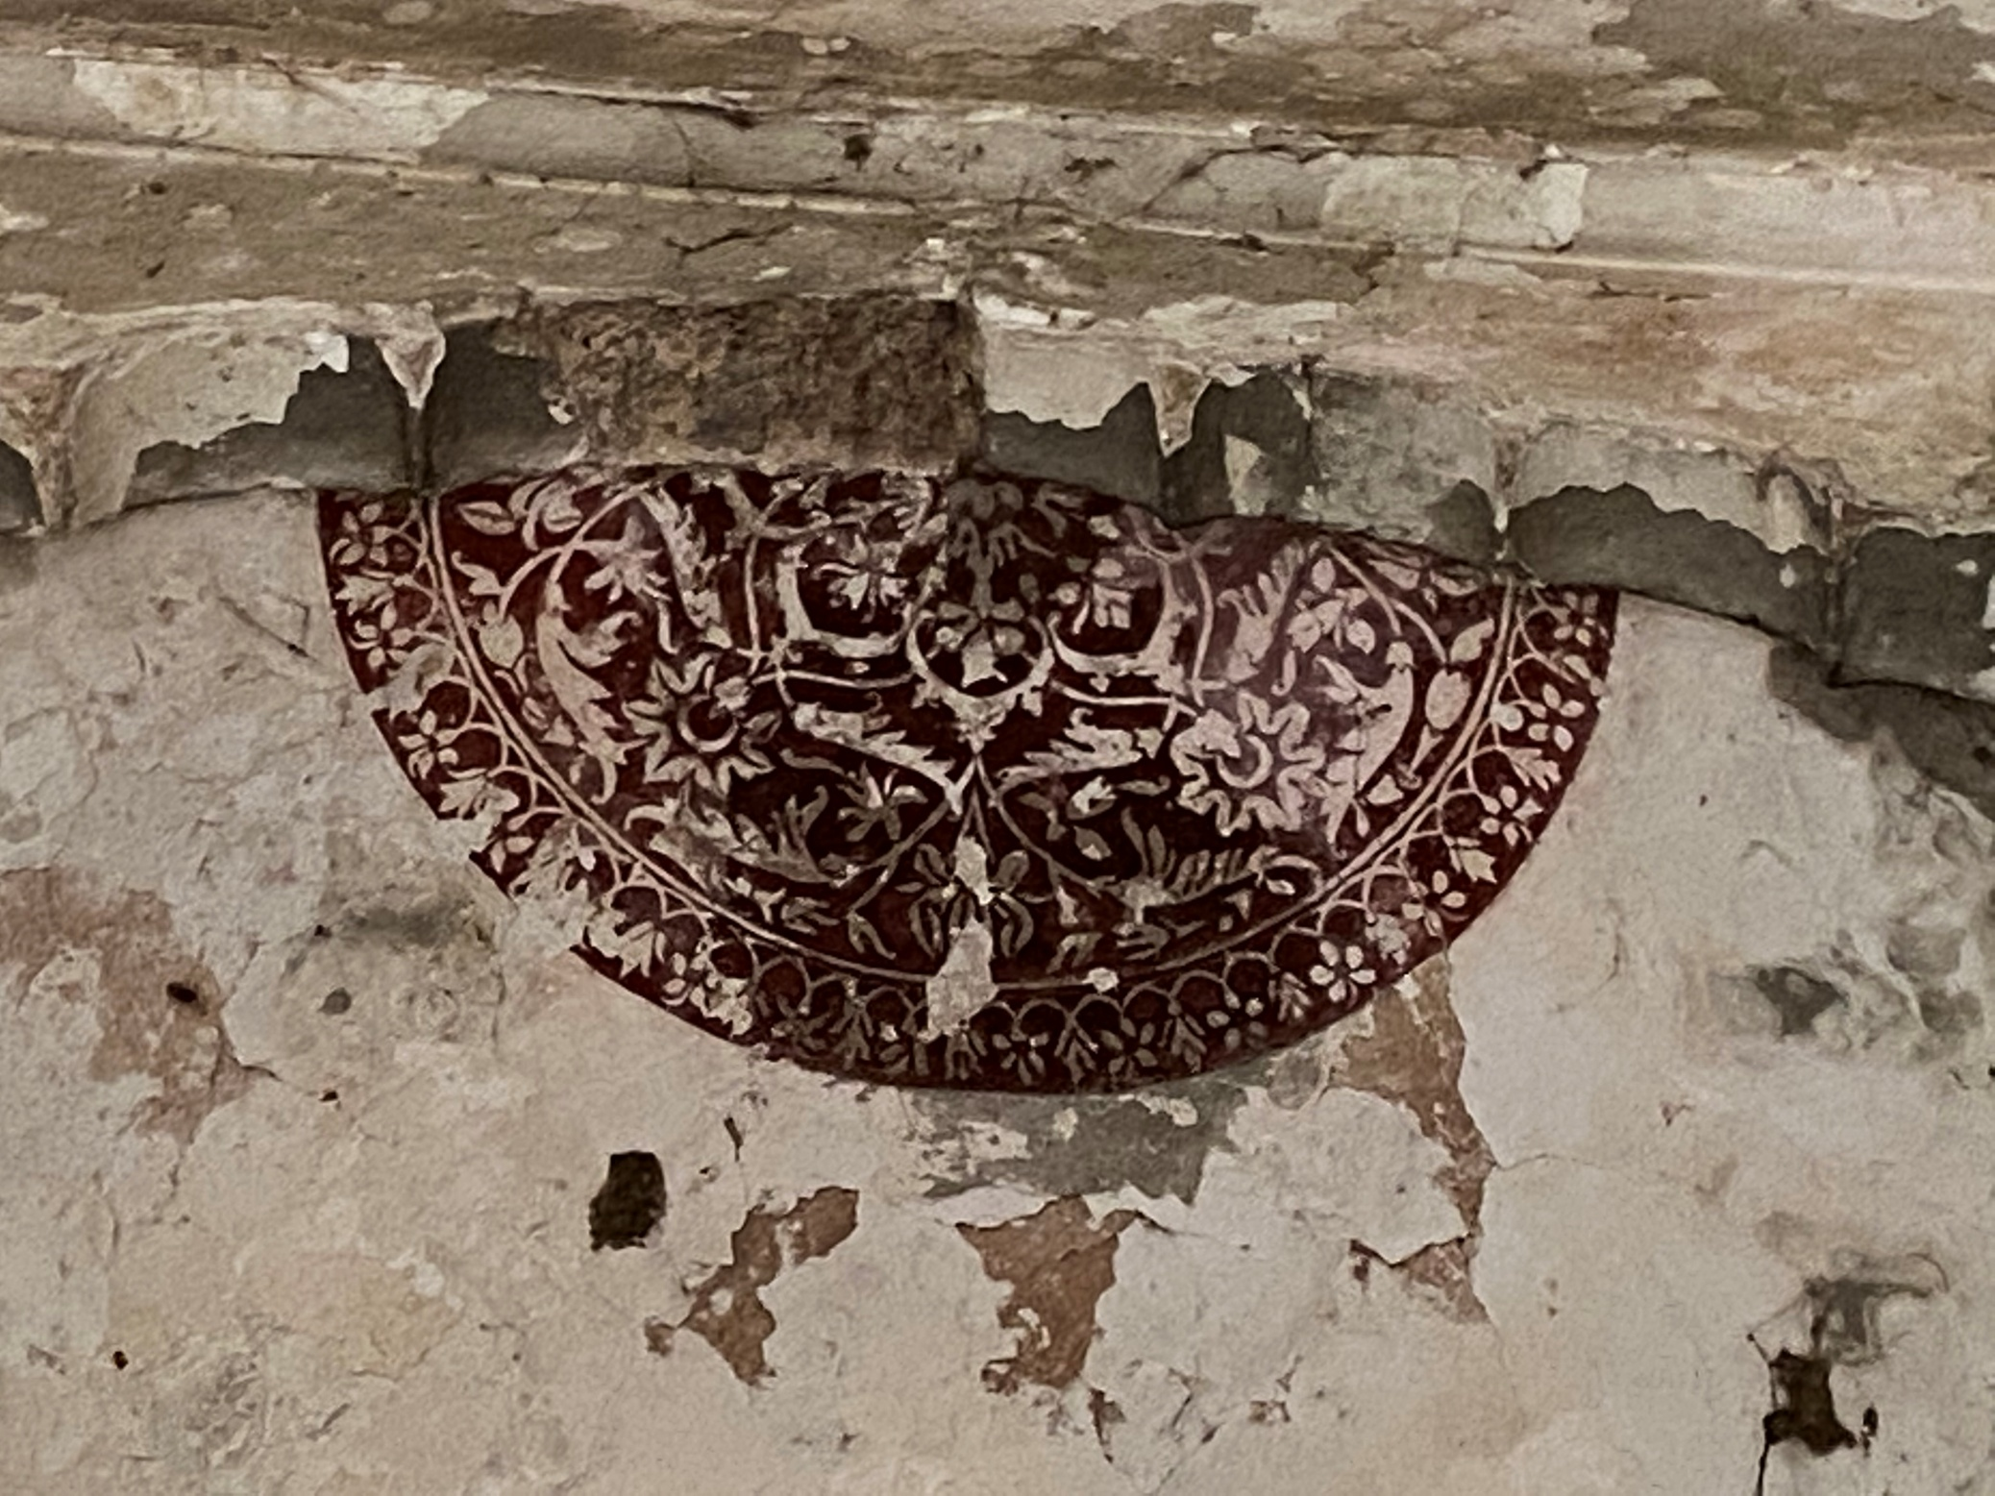
Architectural Assessment
Beautiful painting found in the inner walls and doom

Slide 5
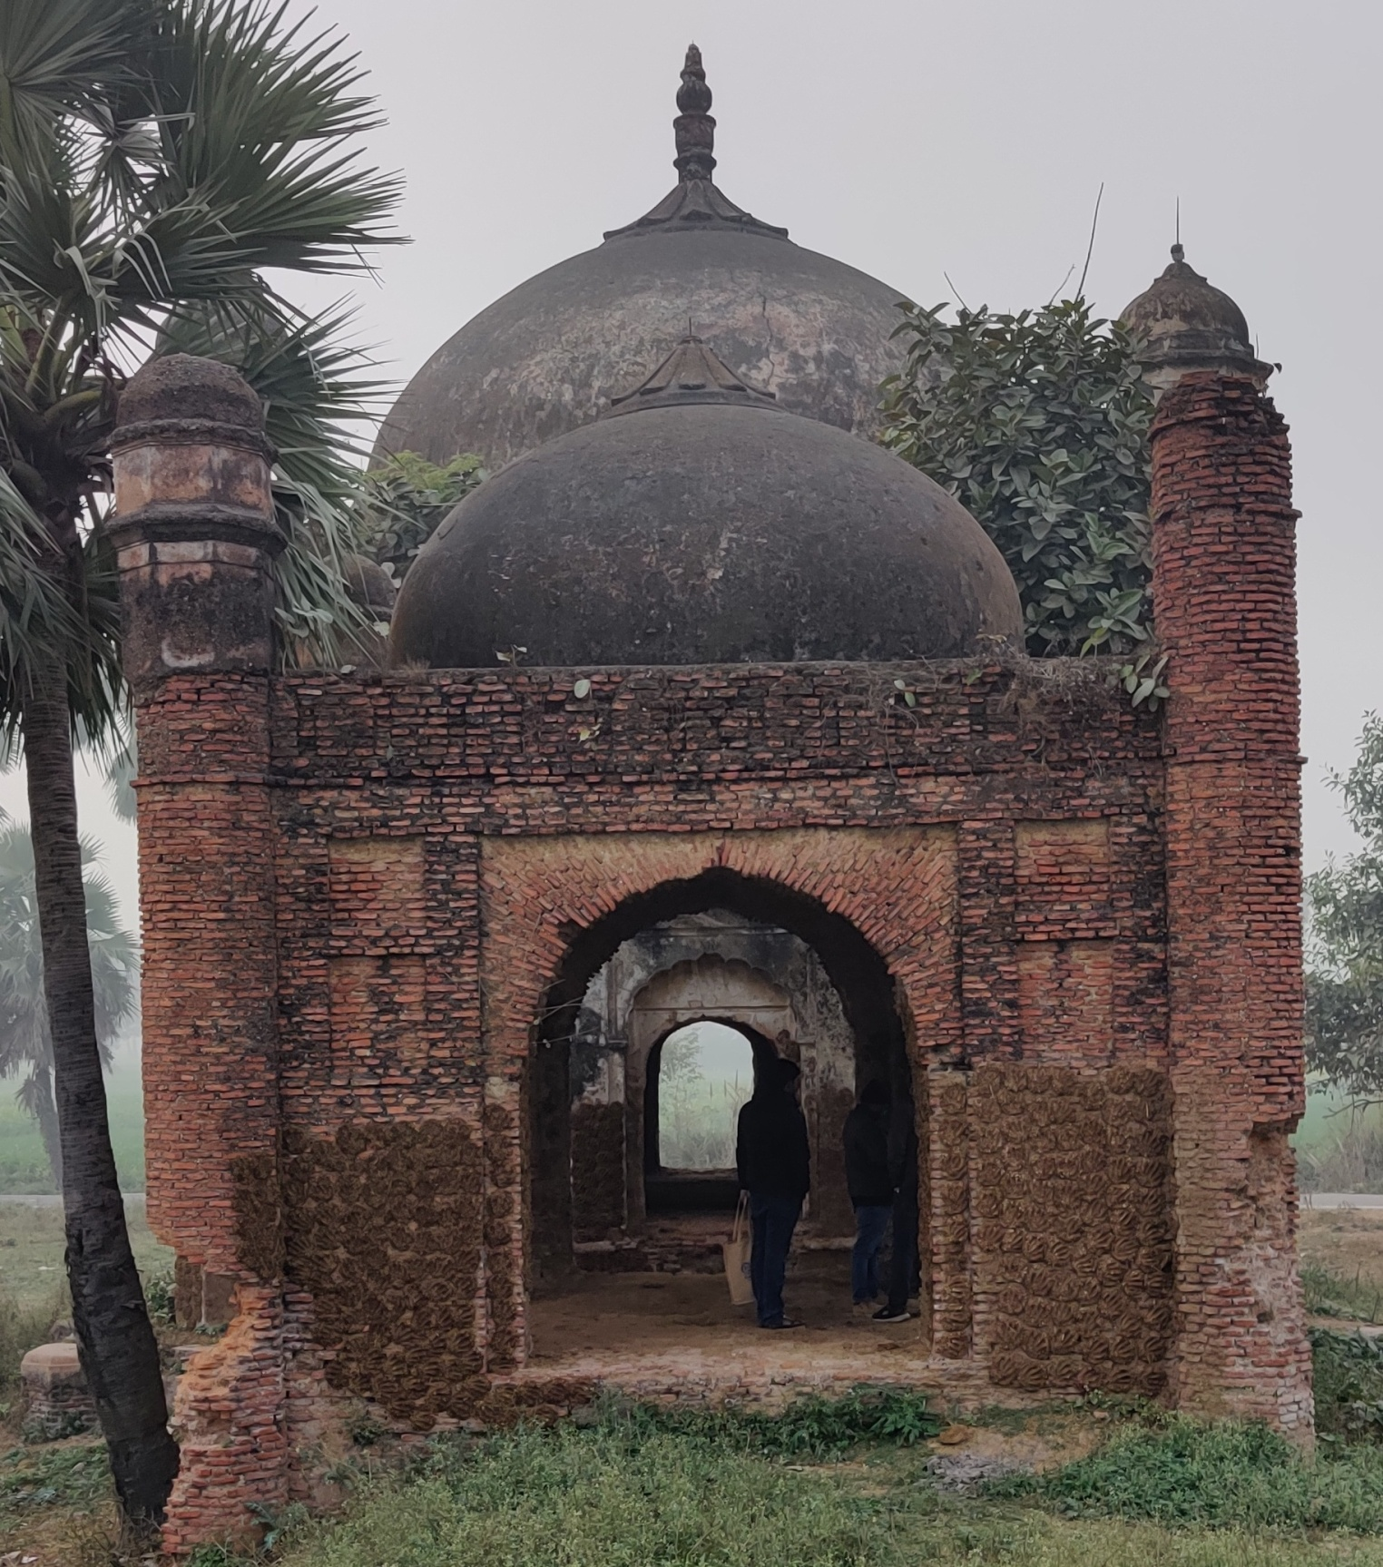
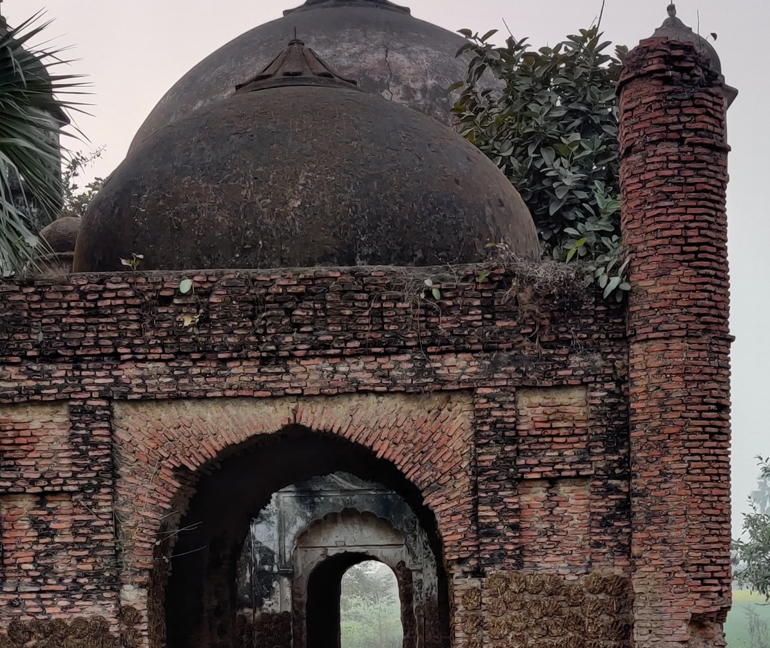
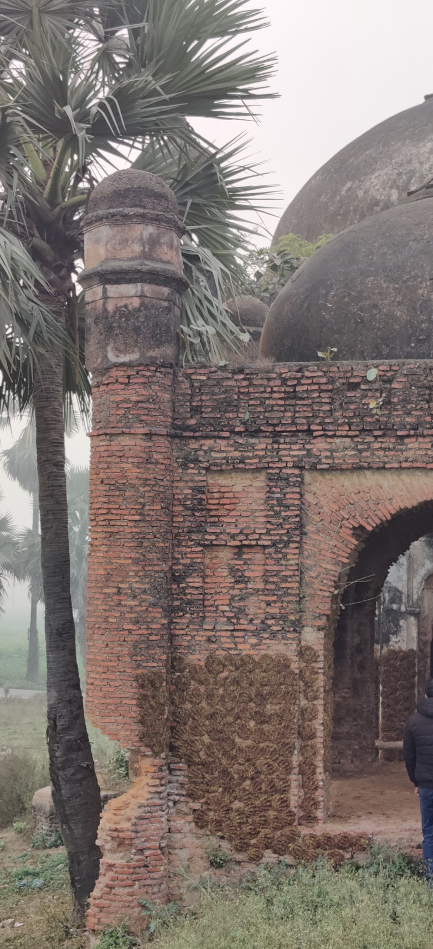
Structural Assessment
The other building having only brick structure with a doom and pillars on four side.

Slide 6
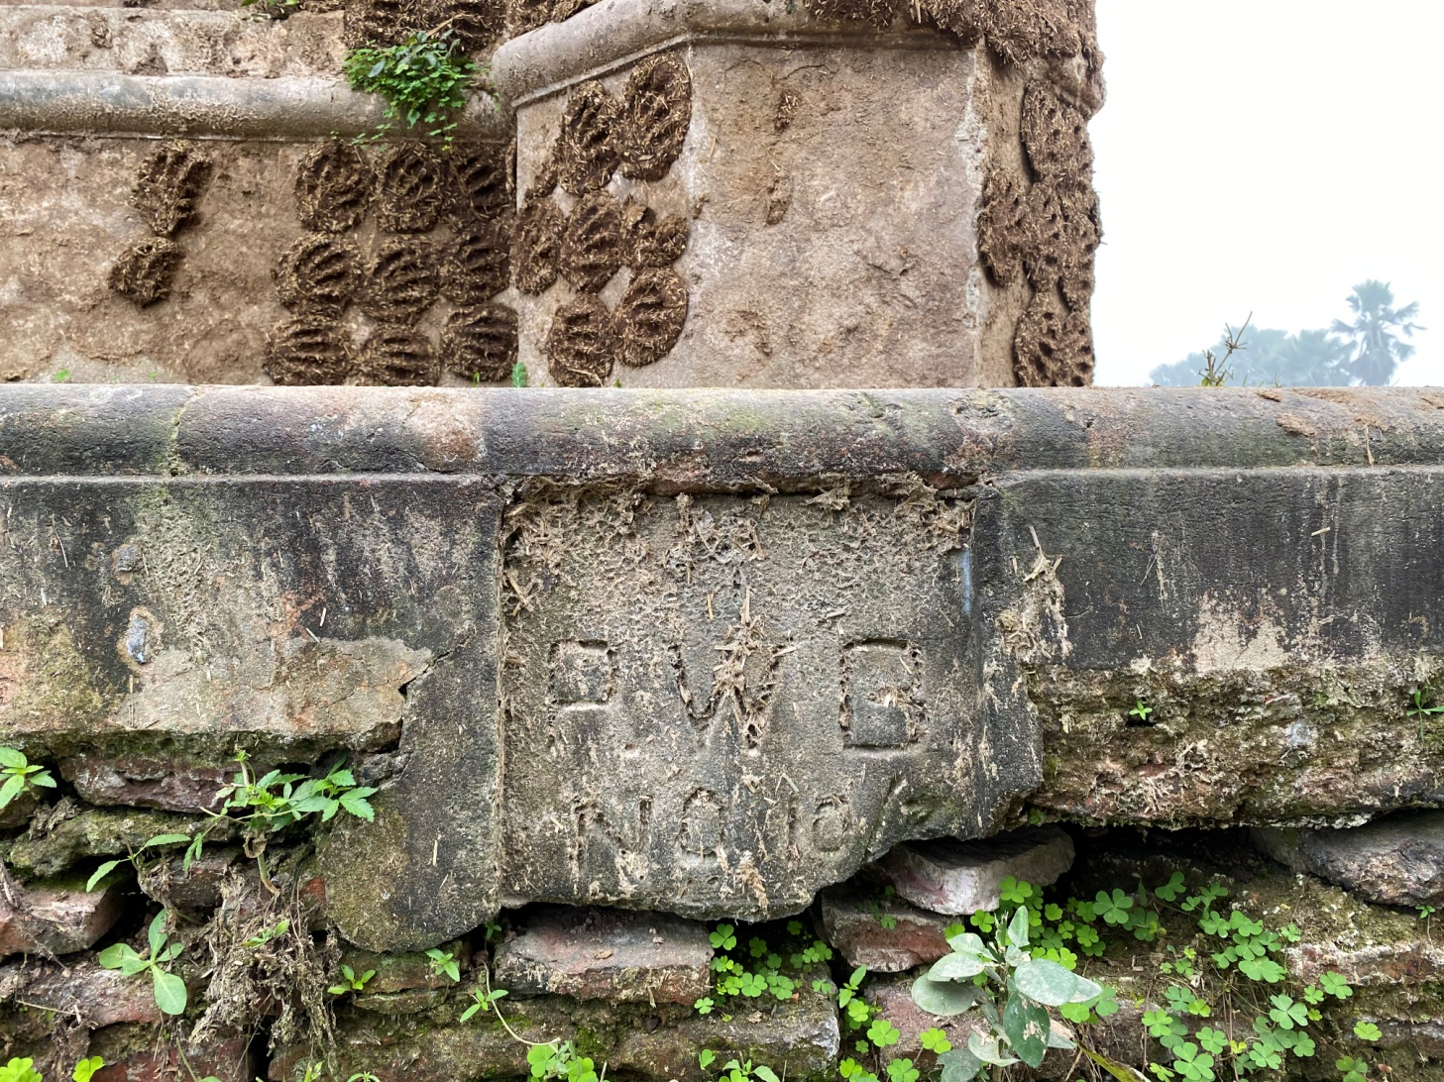
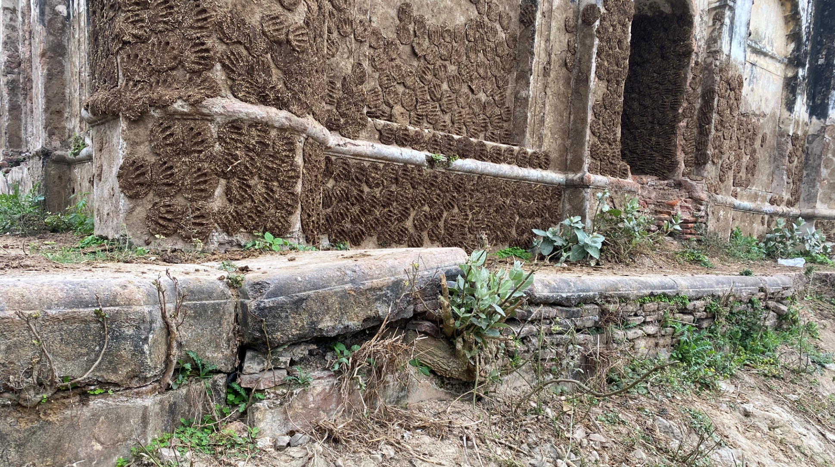
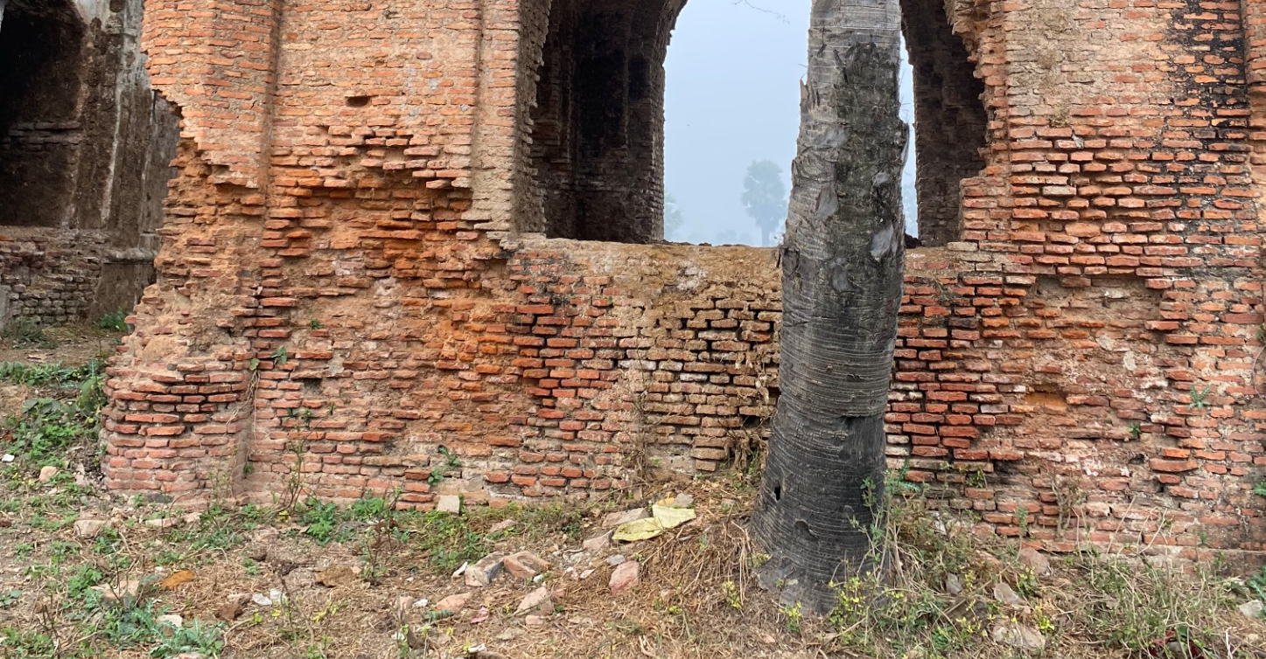
Structural Assessment
Decayed foundation and plinth

Slide 7
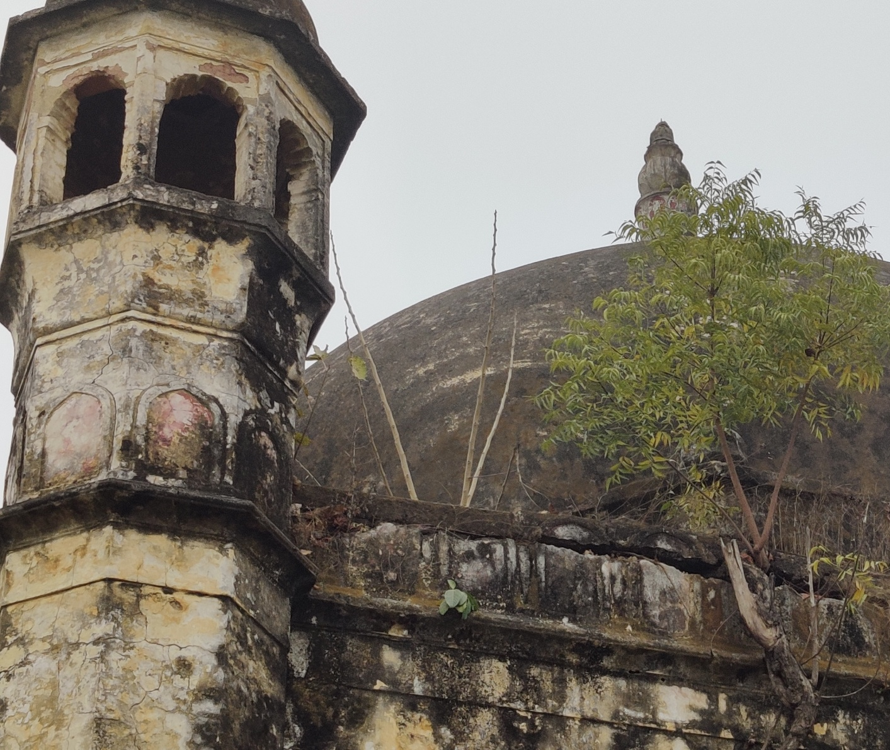
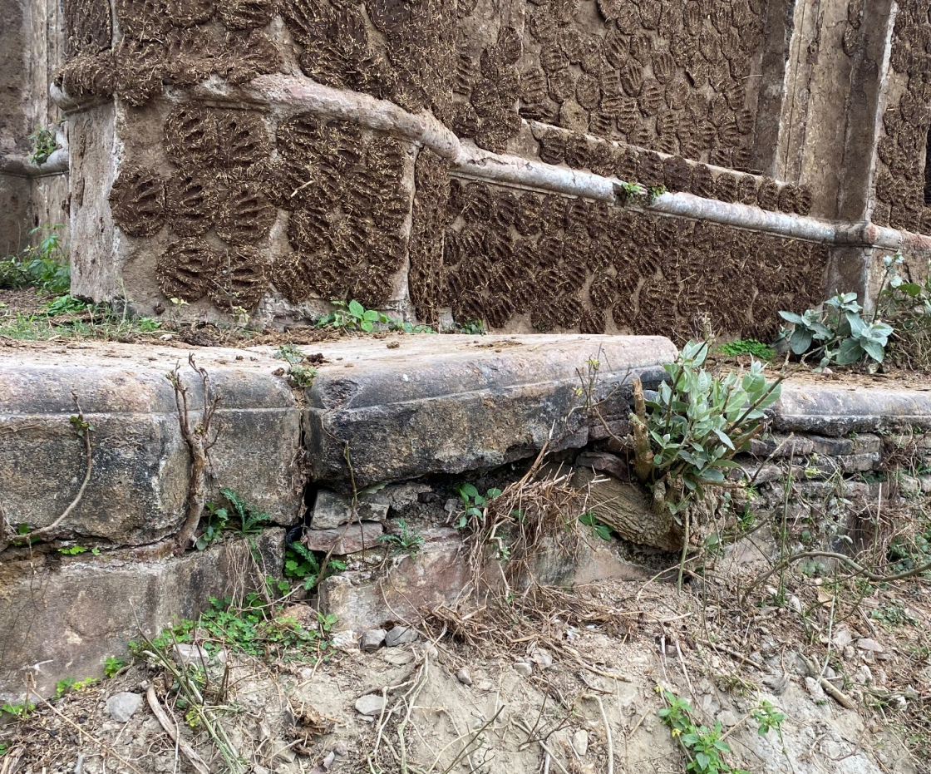
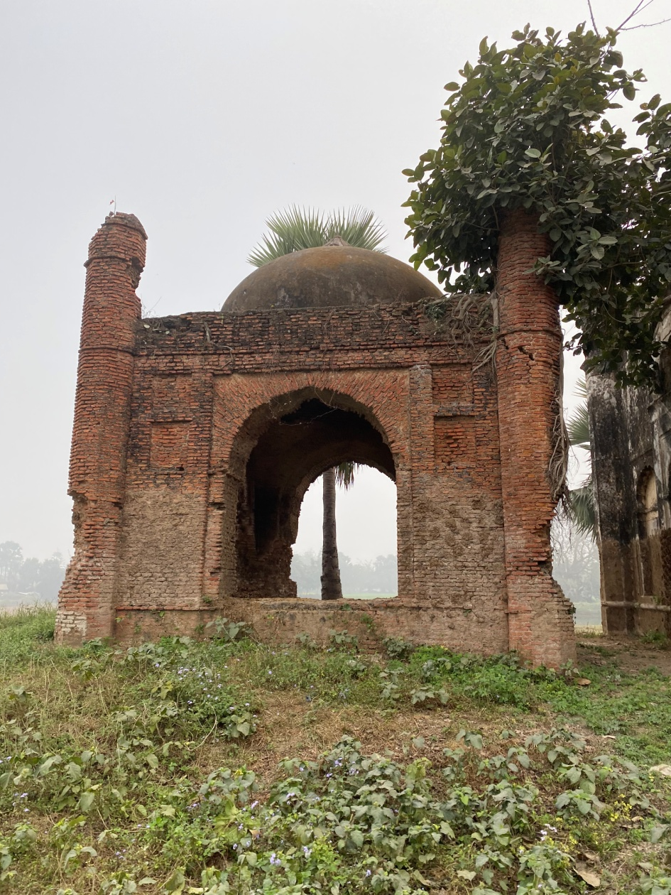
Status of Cracks
Large Cracks / damaged base of the building
The roof top façade of the building has been extensively damaged. It has found to be repaired time and again with cement work. Large cracks can be observed on the facade.
Cracks found on the Pillar of the building

Slide 8
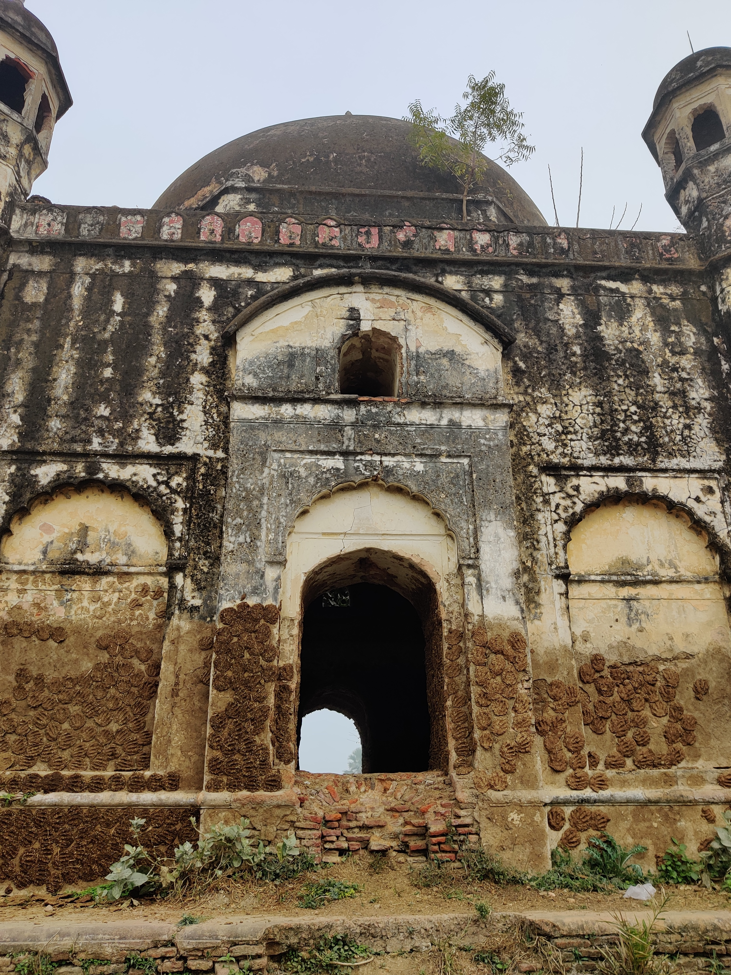
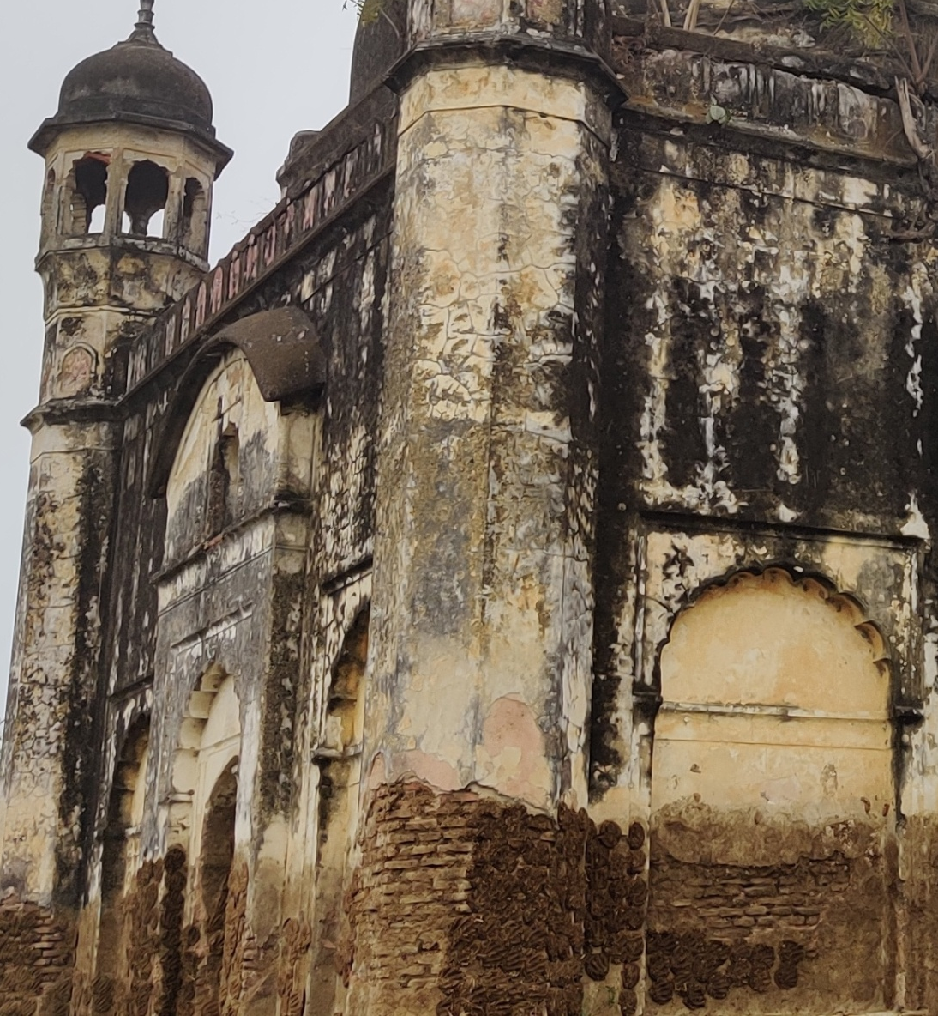

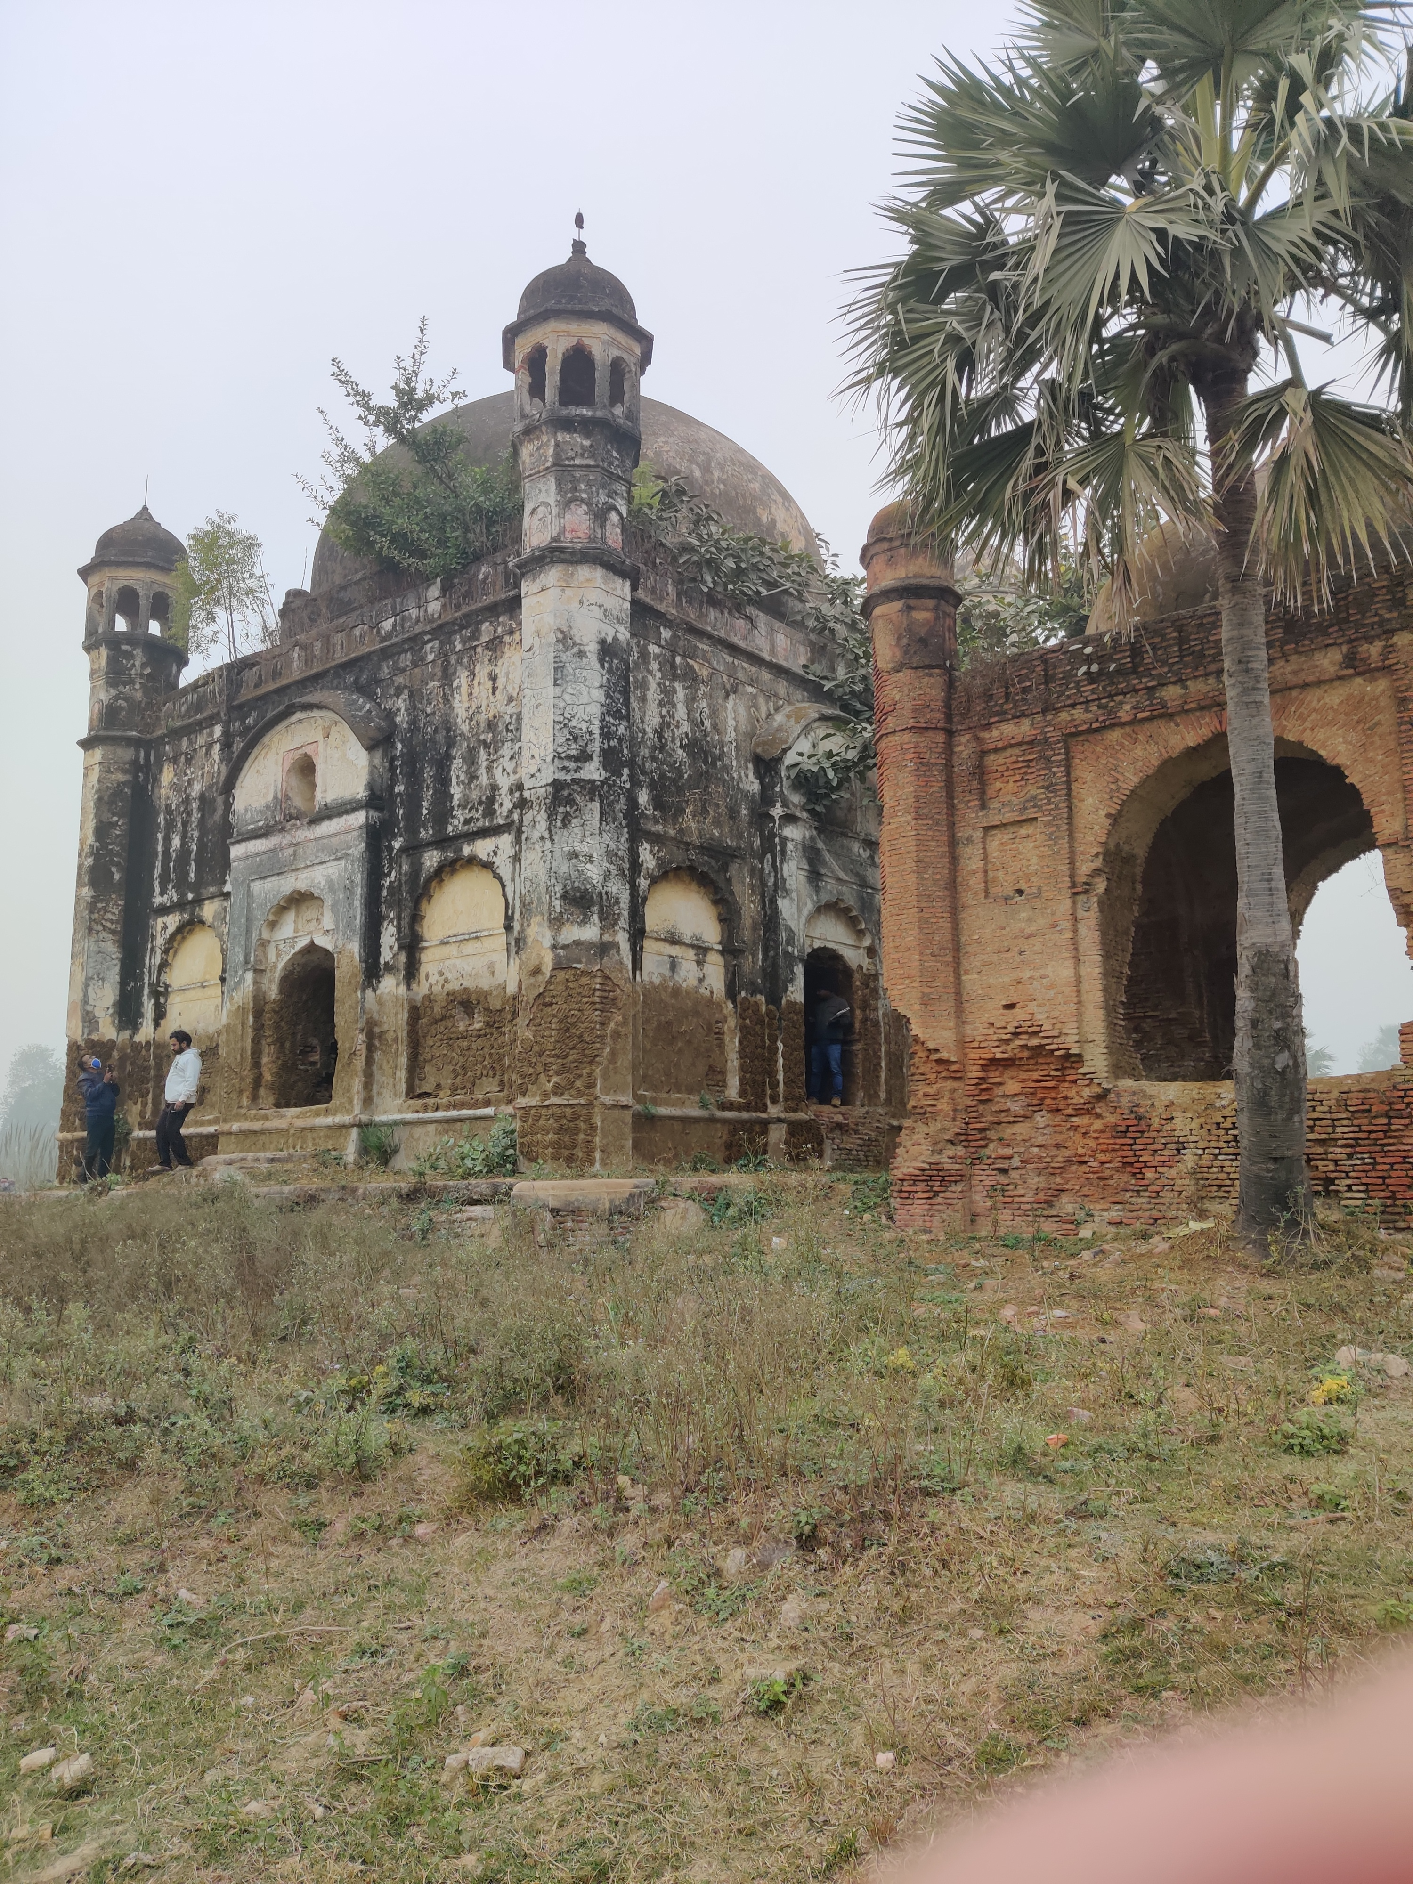
Defect Mapping (External)
At most of the places the lime surkhi plaster has become loose. Decay of lime surkhi was observed in many places. At some places it was plastered using cement.

Slide 9

Defect Mapping (External)
On another side of the building the lime surkhi plaster has vanished from the building.
The pillars has damaged and need to be conserved.

Slide 10
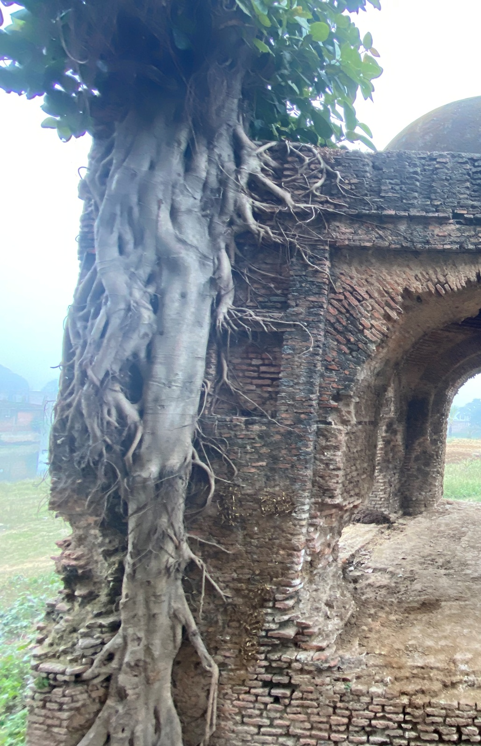
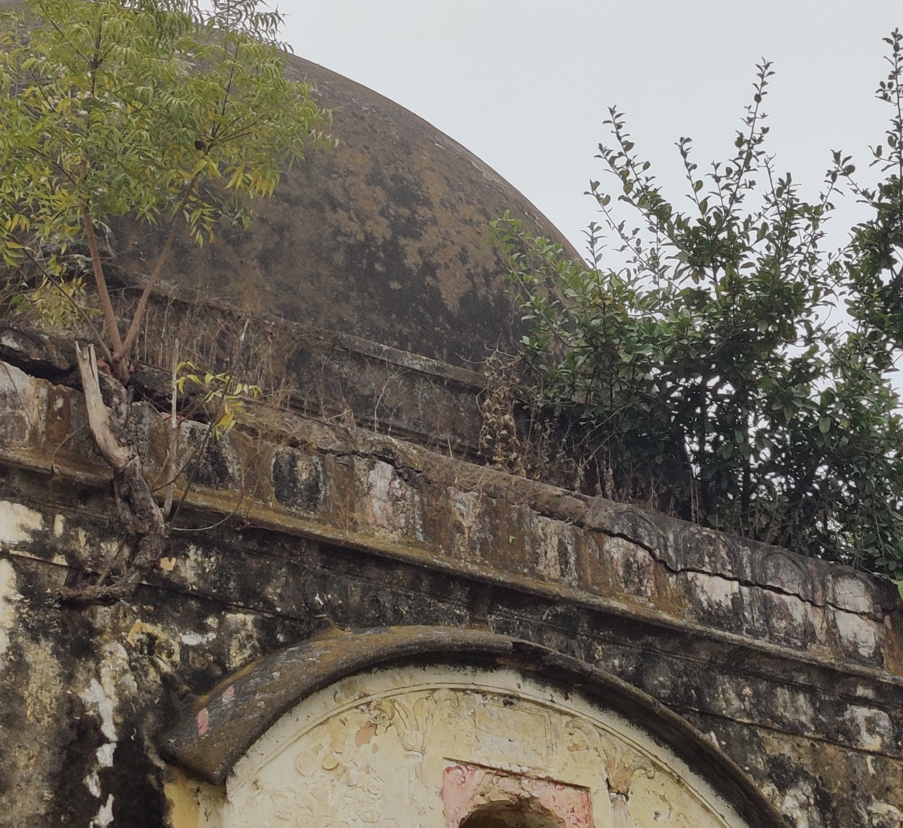
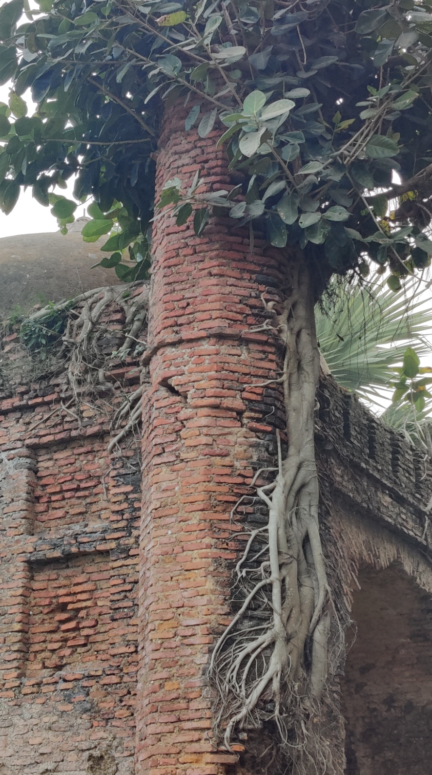
Defect Mapping (External)
Vegetation Growth can be observed on top façade & pillars of the building which needs to be taken care of immediately.

