Slide 1
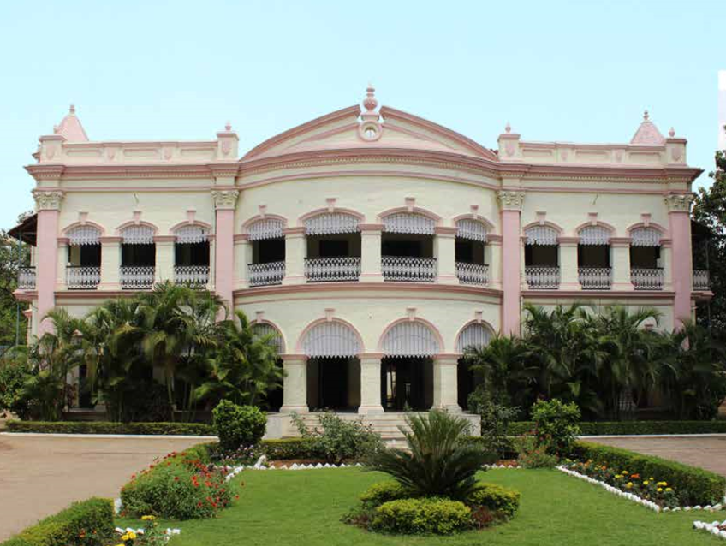

Conservation Proposal
BIT Lalpur Extension Centre, Ranchi
Prepared By
Indian Trust for Rural Heritage and Development

Slide 2
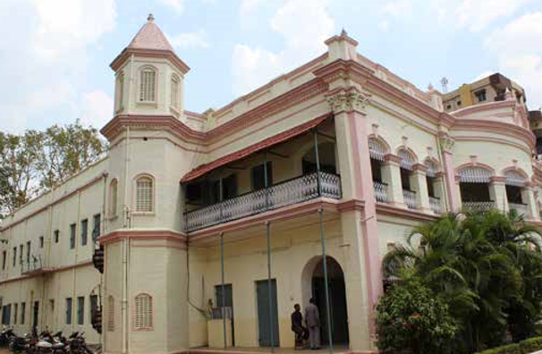
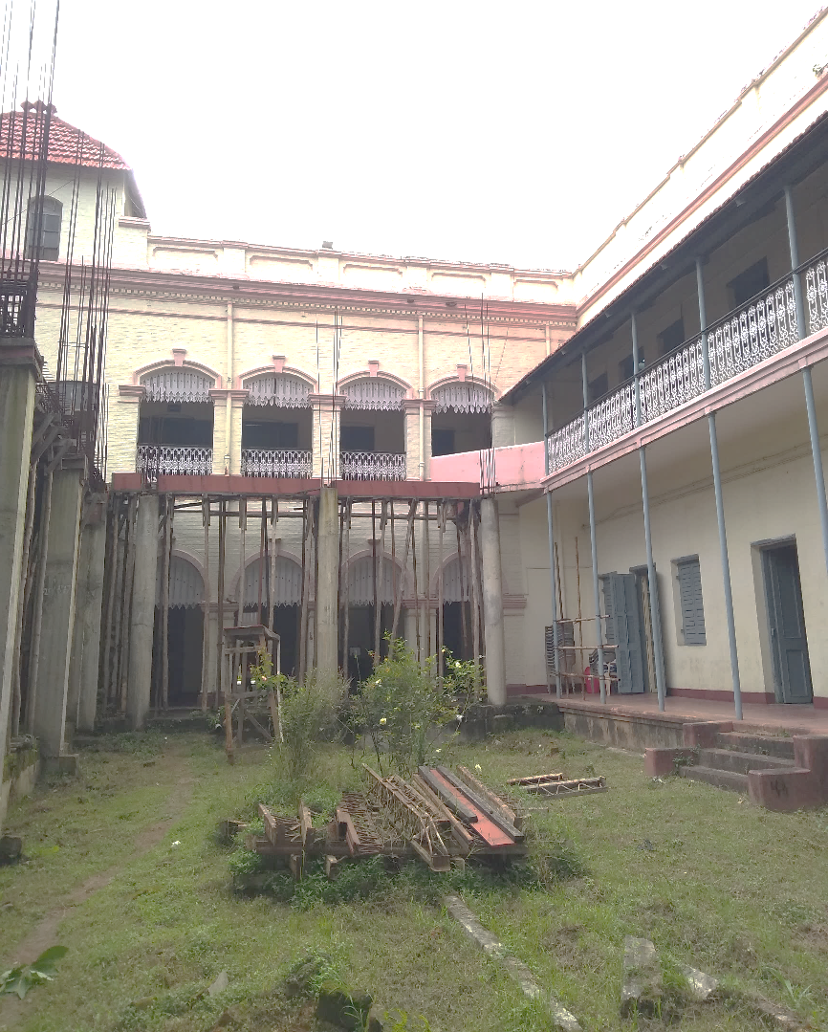
Architectural Assessment
Fig 27
This Heritage building is one of the building with old colonial style of architecture with extensive wood work. Wooden screens can be seen on the front elevation and extensively used in the whole building.
Fig 28
Old colonial style of architecture with Corinthian pillars and steel columns with Mangalore tile roofing.
Fig 29
Steel columns and steel detailed railing can be observed on the veranda.

Slide 3
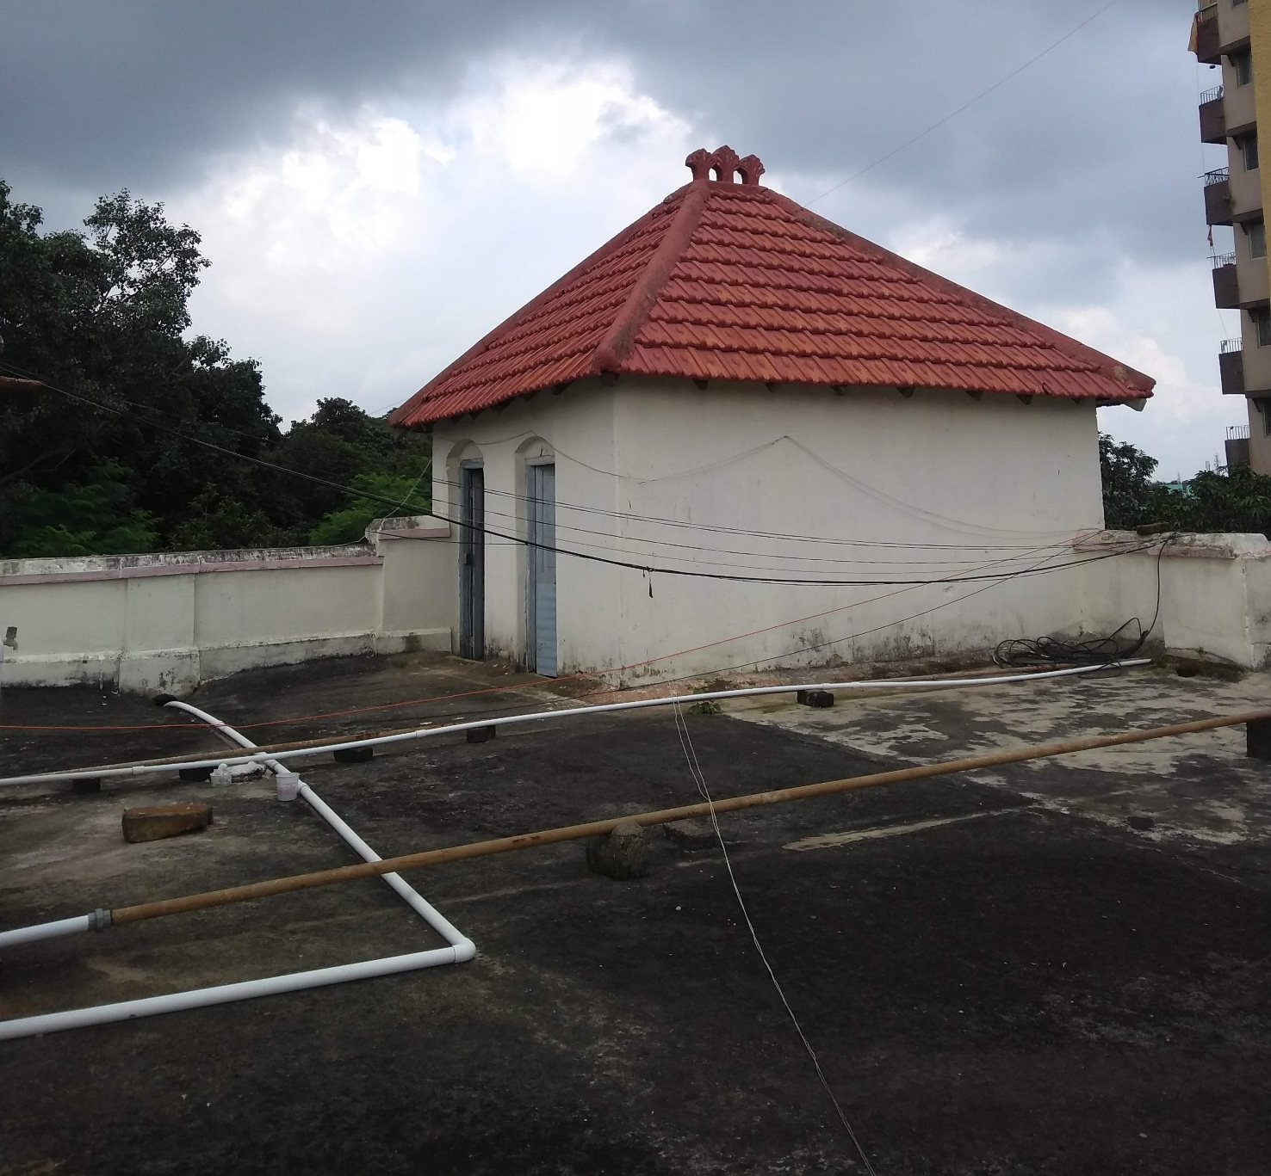
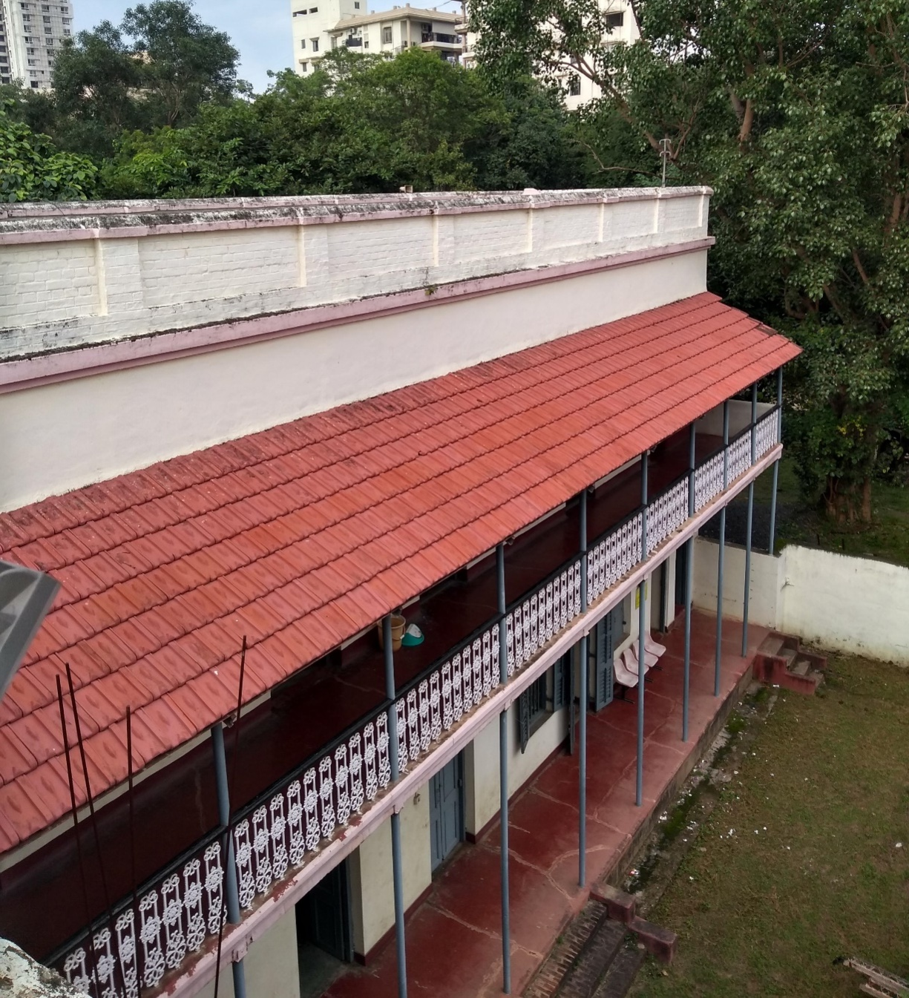
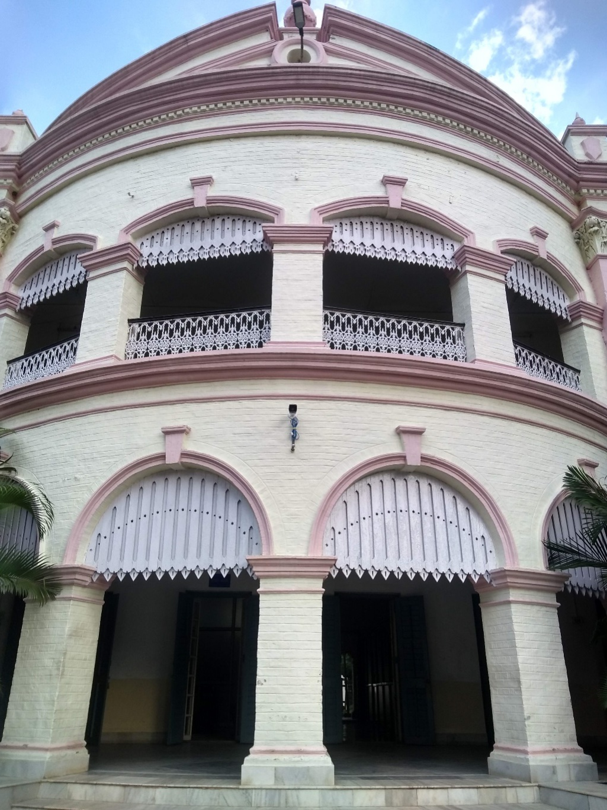
Architectural Assessment
Fig 30
Mangalore tile roofing with steel supported veranda and decorative railing
Fig 31
Mangalore tile roofing is being used in the building.
Fig 32
Extensive wooden jaali work/screening is being used on the arch opening.

Slide 4
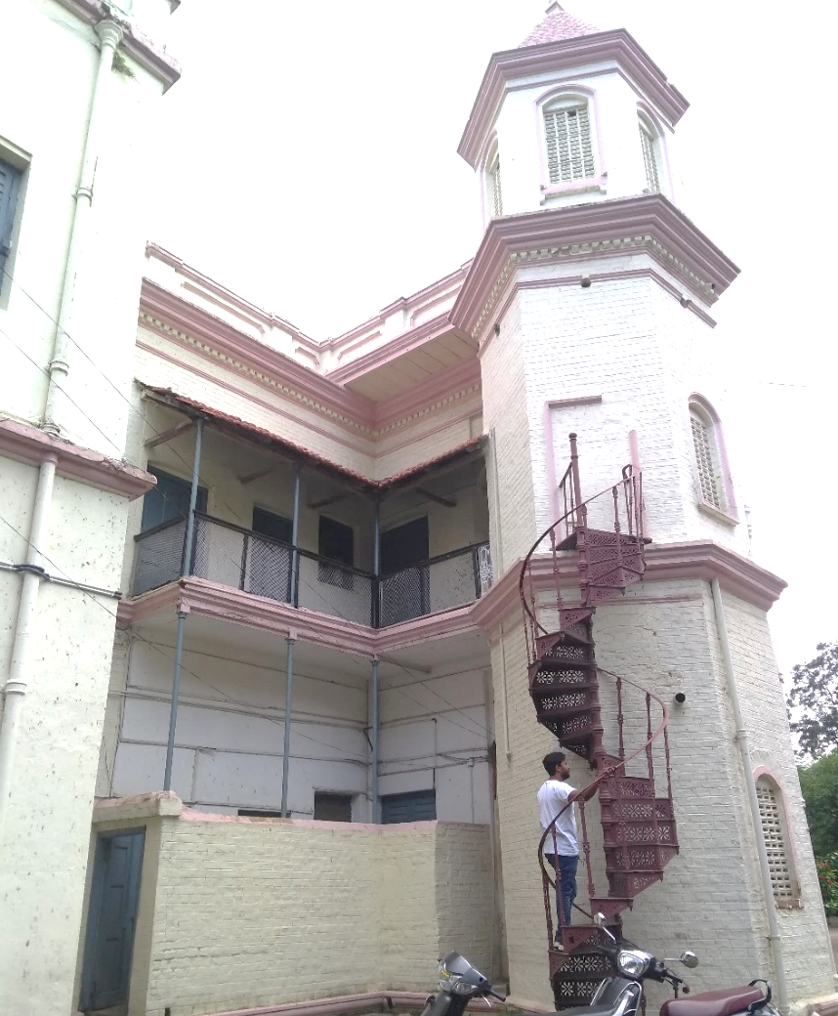
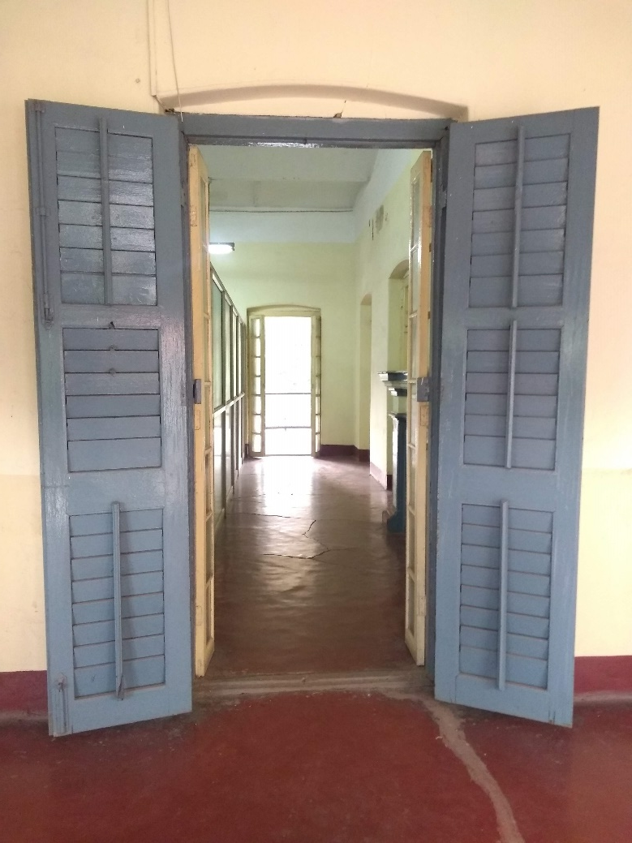
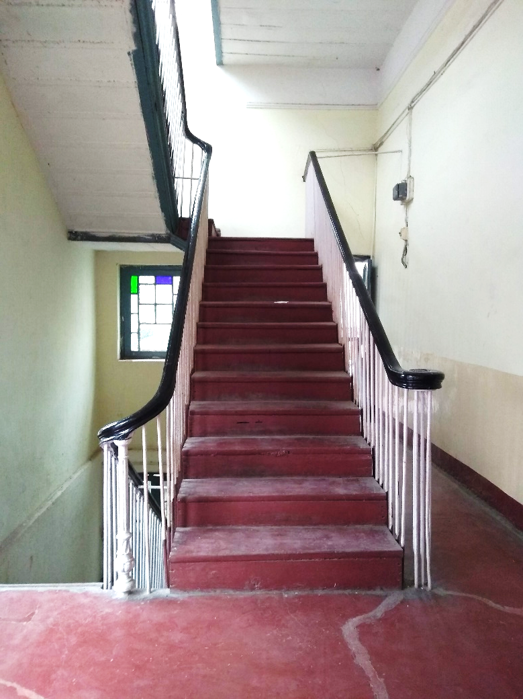
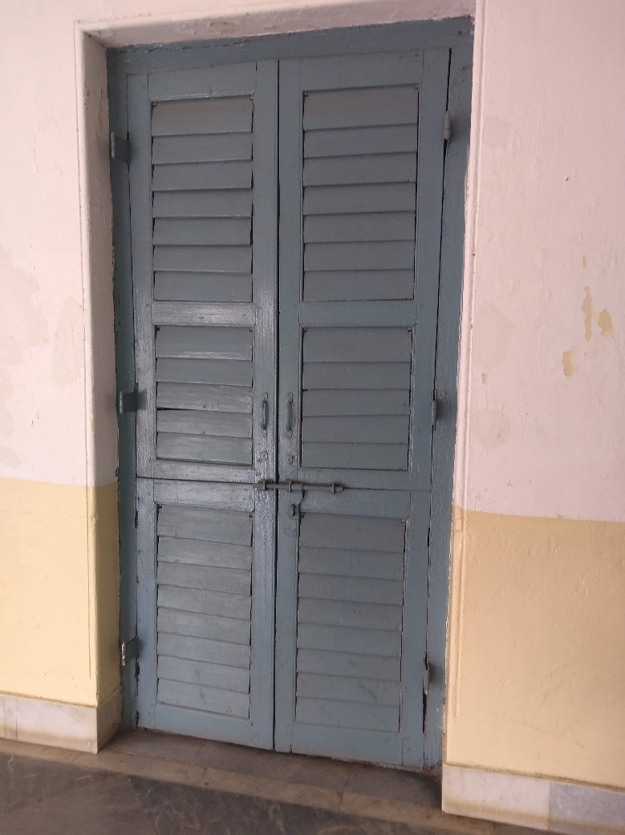
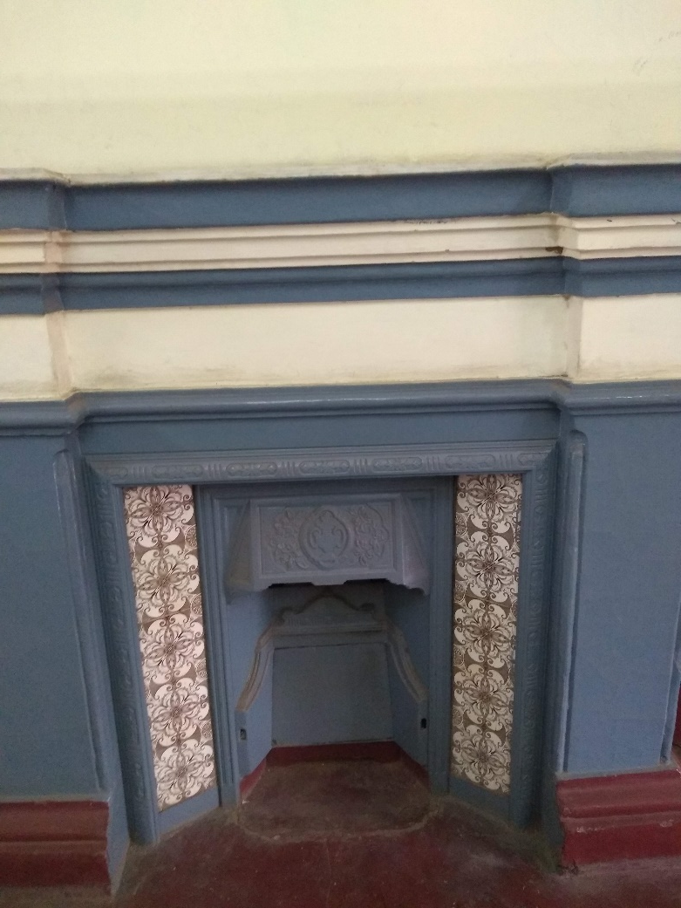
Architectural Assessment
Fig 33
Spiral staircase with extensive detailing can be seen on the north and south towers of the building.
Fig 34
Wooden staircase with steel railing.
Fig 35
Louvered doors and windows can be observed in the building.
Fig 36
Two fire place was also inspected which can be restored because adds up to the identity of the heritage building

Slide 5
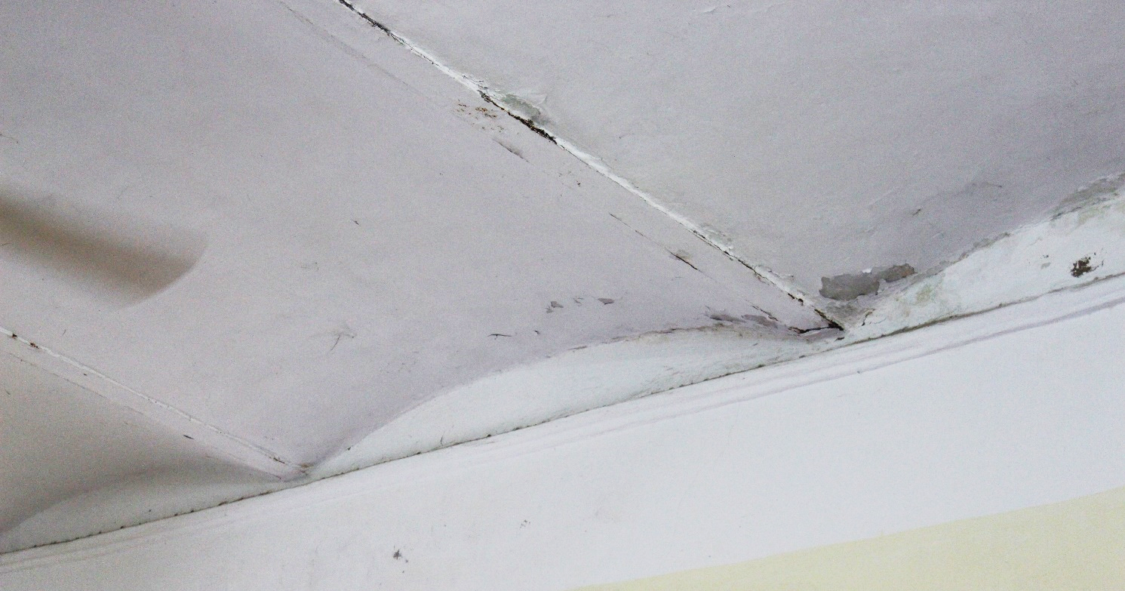
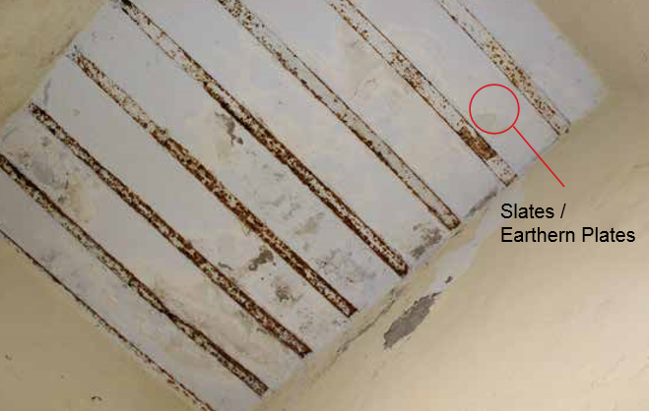
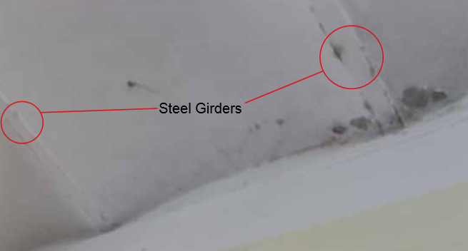
Structural Assessment
Fig 39
Jack arch roofing can be seen as most of the heritage buildings of that time have used jack arches.
Fig 37 & 38
Steel girders with slates/earthen plates have been used to support the roof
Fig 40

Slide 6
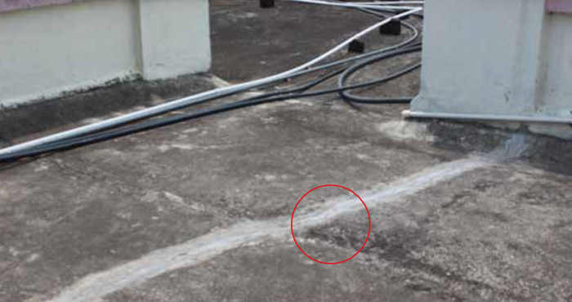

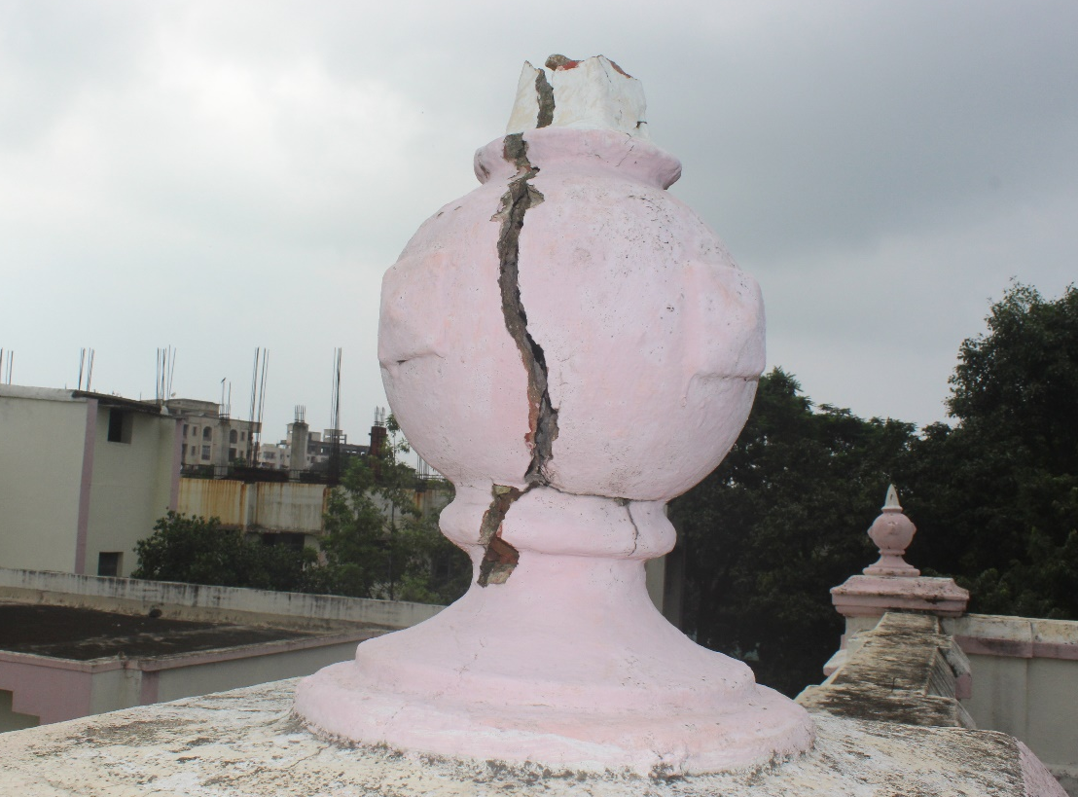
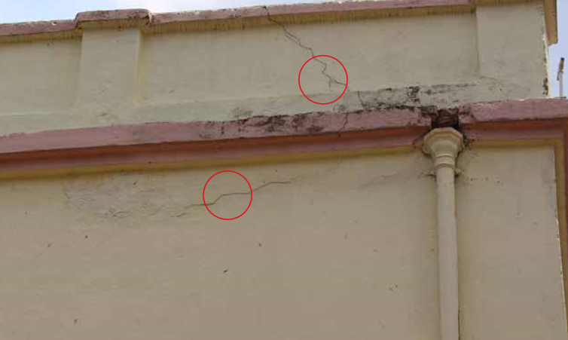
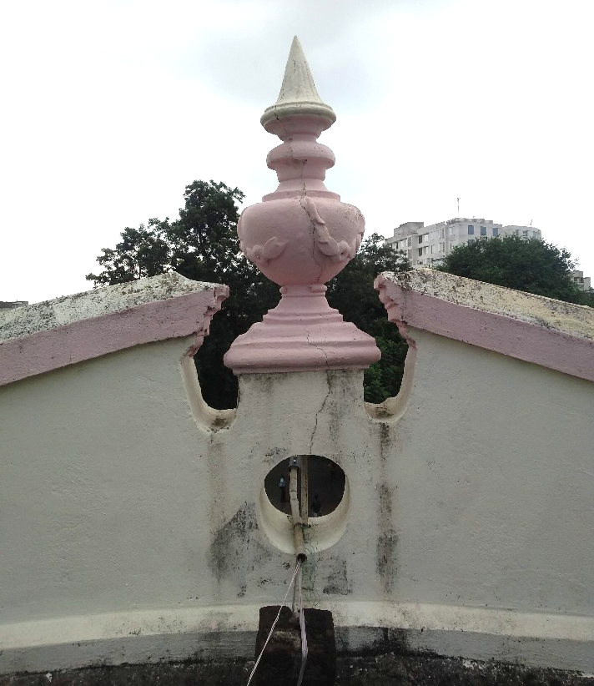
Status of Cracks
Fig 41 & 42 The roof top of the building has been extensively damaged. It has found to be repaired time and again with cement work. Large cracks can be observed oh the roof.
Fig 43 & 44 Cracks can be observed on the minaret and is
severely damaged
Fig 45 Cracks can be observed on the exterior wall.

